Slide 1

Data 603 – Big Data Platforms
Lecture 9
Apache Spark MLlib - Part 1

Slide 2

More on Structured Streaming

Slide 3
Machine Learning
Process for extracting patterns from the data using statistics, linear algebra, and numerical optimization.
Types of machine learning:
Supervised
Semi-supervised
Unsupervised
Reinforcement Learning

Slide 4
Supervised Learning
Data consists of a set of input records each with associated labels.
The goal is to predict the output label(s) given a new unlabeled input
The output labels can either be discrete or continuous.
Classification
Separate the inputs into a discrete set of classes (labels).
Binary classes: two discrete values
Multiclass/Multinomial classification: three or more discrete labels.
Regression
The value to predict is a continuous number

Slide 5
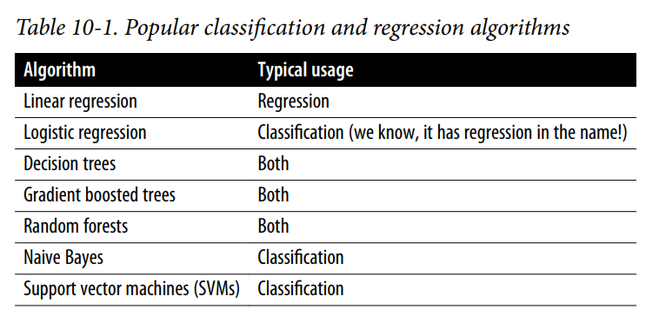
Supervised Learning Supported by Spark MLlib

Slide 6
Unsupervised Learning
Obtaining the labeled data required by supervised machine learning can be very expensive and/or infeasible.
https://www.mturk.com/
Instead of predicting a label, unsupervised ML helps to understand the structure of the data.
Can be used for outlier detection or as a preprocessing step for supervised machine learning
Reducing the dimensionality of the data set
K-means
Latent Dirichlet Allocation (LDA)
Gaussian mixture models

Slide 7
Spark Machine Learning
Provides an ecosystem for data ingestion, feature engineering, model training and deployment
Traditionally, developers needed to use different tools for each of these tasks.
Spark has two machine learning packages
spark.mllib
Original machine learning API based on RDD API (in maintenance mode since Spark 2.0)
spark.ml
Newer API based on DataFrames.
“Mllib” is used as an umbrella term to refer to both machine learning packages.
spark.ml focuses on O(n) scale-out

Slide 8

ML Pipelines
https://spark.apache.org/docs/latest/ml-pipeline.html

Slide 9
ML Pipelines
Pipeline = Workflow
MLlib standardizes APIs for machine learning algorithms into a single pipeline.
The concept of the pipeline is inspired by scikit-learn.

Slide 10
ML Pipelines
DataFrame: ML API uses DataFrame from Spark SQL as an ML dataset, which can hold a variety of data types. E.g., a DataFrame could have different columns storing text, feature vectors, true labels, and predictions.
Transformer: An algorithm which can transform one DataFrame into another DataFrame. E.g., an ML model is a Transformer which transforms a DataFrame with features into a DataFrame with predictions.
Estimator: An algorithm which can be fit on a DataFrame to produce a Transformer. E.g., a learning algorithm is an Estimator which trains on a DataFrame and produces a model.
Pipeline: A Pipeline chains multiple Transformers and Estimators together to specify an ML workflow.
Parameter: All Transformers and Estimators now share a common API for specifying parameters.

Slide 11
Machine Learning Pipelines
MLlib Terminology
DataFrame
ML can be applied to a wide variety of data types including vectors, text, images, and structured data.
DataFrame can use ML Vector types
For Python, MLlib recognizes the following types as dense vectors:
NumPy’s array <- More efficient
Python’s list, e.g., [1, 2, 3]
and the following as sparse vectors:
MLlib’s SparseVector.
SciPy’s csc_matrix with a single column
https://spark.apache.org/docs/latest/mllib-data-types.html#local-vector
https://spark.apache.org/docs/latest/api/python/reference/api/pyspark.mllib.linalg.Vectors.html

Slide 12
Machine Learning Pipelines
MLlib Terminology
Transformer
Accepts a DataFrame as input, returns a new DataFrame with one or more columns appended to it.
An abstraction that includes feature transformers and learned models.
A feature transformer reads a column, map it into a new column (e.g. feature vectors), and output a new DataFrame with the mapped column appended
A learning model might take a DataFrame, read the column containing feature vectors, predict the label for each feature vector, and output a new DataFrame with predicted labels appended as a column.
Do not learn any parameters from the data.
Simply applies rule-based transformations to either prepare data for model training or generate predictions using a trained MLlib model.
.transform() method

Slide 13
Machine Learning Pipelines
MLlib Terminology
Estimator
Abstracts the concept of a learning algorithm.
Learns (or “fits”) parameters from the DataFrame
Returns a Model, which is a transformer
.fit() method
Accepts a DataFrame and produces a Model.
e.g. LogisticRegression is an Estimator, and calling fit() trains a LogisticRegressionModel, which is a Model and hence a Transformer

Slide 14
Machine Learning Pipelines
MLlib Terminology
Pipeline
Created to support the common pattern in ML to run a sequence of algorithms to process and learn from the data
E.g. Split each document’s text into words -> convert each document’s words into a numerical feature vector -> learn a prediction model using feature vectors and labels
Provides a high-level API built on top of DataFrames to organize the machine learning workflow.
Composed of a series of transformers and estimators
A Pipeline consists of a sequence of PipelineStages (Transformers and Estimators) to be run in a specific order.
Pipelines are estimators.
Pipeline.fit() returns a PipelineModel, a transformer.

Slide 15
Machine Learning Pipelines
MLlib Terminology
Pipeline (Cont.)
A Pipeline is a sequence of stages
Each stage is either a Transformer or an Estimator
Stages are run in order
An input DataFrame is transformed as it passes through each stage

Slide 16
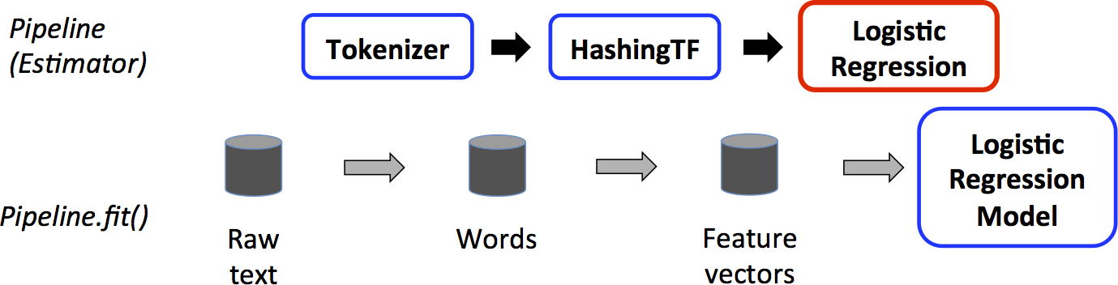
Machine Learning Pipelines
Transformer
Training time usage of a Pipeline
Data flow
Three stage pipeline
Tokenizer and HasingTF are Transformers
LogisticRegression is an Estimator
After a Pipeline’s fit() method runs, a PipelineModel (a Transformer) is produced

Slide 17
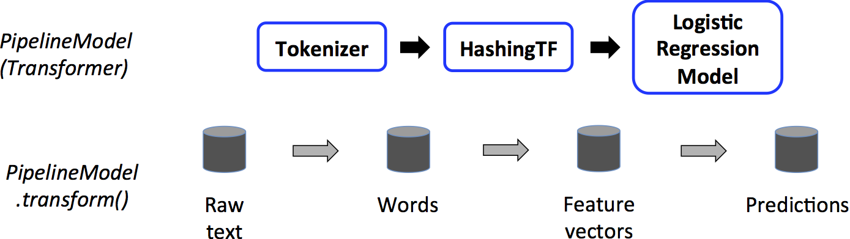
Machine Learning Pipelines
Testing time usage of a Pipeline
All Estimators in the original Pipeline have become Transformers
PipelineModel.transform() triggers data to be passed through the fitted pipeline in order
Each stage’s transform() updates the dataset and passes it to the next stage

Slide 18

Training and Test Data Sets
https://spark.apache.org/docs/latest/ml-pipeline.html

Slide 19
Training and Test Data Sets
Dividing the data
Standard convention 80/20 (train/test) split
Reason for not using the whole data set:
It is possible for the model to “memorize”, or “overfit”, the training data.
We need generalized model.
The model’s performance on the test set is a proxy for how well it will perform on unseen data with similar distributions.
Define a seed value for reproducibility.
Rerunning the code will get the same data points going to the train and testing sets. Only guaranteed with same numbers of executors.
Split data once and write it to its own train/test folder to reduce the reproducibility issues.

Slide 20
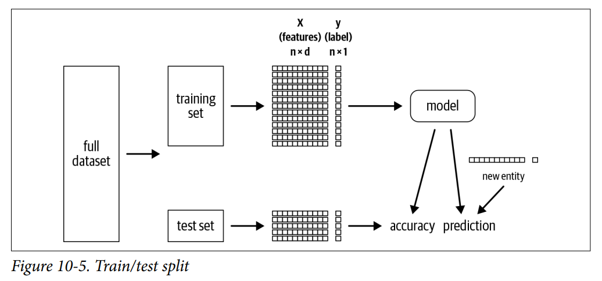
Training and Test Data Sets
Training Set:
A set of features, X, and a label, y
X is a n x d matrix, n = number of data points (rows, examples), d is the number of features (fields, columns)
y, denotes a n x 1 vector. For every example (row), there is one label

Slide 21
Preparing Features with Transformers
Linear regression requires all the input features are contained within a single vector in a DataFrame.
The data needs to be transformed.
Spark Transformers
Accept a DataFrame as input and return a new DataFrame with one or more columns appended.
They do not learn from the data
They apply rule-based transformations using the transform() method.

Slide 22
Preparing Features with Transformers
VectorAssembler transformer
Used to put all features into a single vector
Takes a list of input columns and creates a new DataFrame with an additional column (features).
Combines the values of the input columns into a single vector.
from pyspark.ml.feature import VectorAssembler
vecAssembler = VectorAssembler(inputCols=["bedrooms"], outputCol="features")
vecTrainDF = vecAssembler.transform(trainDF)
vecTrainDF.select("bedrooms", "features", "price").show(10)

Slide 23
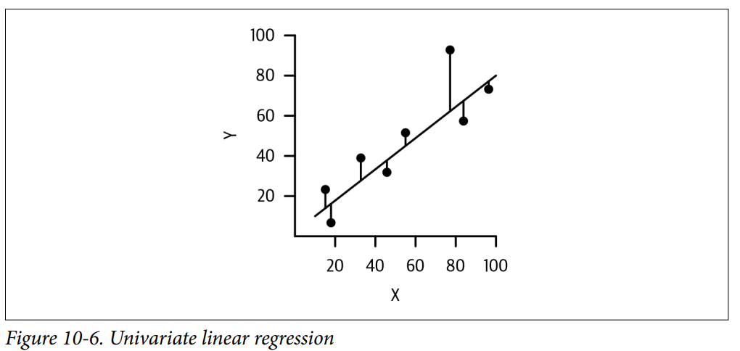
Linear Regression
Linear regression models a linear relationship between the dependent variable (label) and one or more independent variables (features).
Linear regression seeks to fit an equation for a line to x and y.
y= mx +b, m is the slope, b is the offset (intercept).
y_hat = b_0 + b_1*x_1 + … + b_n*x_n + error
… + b_1_2 * x_1*x_2
The goal of linear regression is to find a line that minimizes the square of the residuals (errors between the model predictions and the true values).

Slide 24
Using Estimators to Build Models 1/2
Spark’s LinearRegression is a type of estimator
It takes a DataFrame and returns a Model.
Estimators learn parameters from the data.
It has a fit() method. The output is a transformer.
Estimators are eagerly evaluated (kick off Spark jobs). Transformers are lazily evaluated.
Other examples of estimators
Imputer, DecisionTreeClassifier, RandomForestRegressor, etc.
from pyspark.ml.regression import LinearRegression
lr = LinearRegression(featuresCol="features", labelCol="price")
lrModel = lr.fit(vecTrainDF) # returns a LinearRegressionModel

Slide 25
Using Estimators to Build Models 2/2
Once the estimator has learned the parameters, the transformer can apply the parameters to new data points to generate prediction
Inspecting the parameters LinearRegression estimator learned:
m = round(lrModel.coefficients[0], 2)
b = round(lrModel.intercept, 2)
print(f"""The formula for the linear regression line is
price = {m}*bedrooms + {b}""")

Slide 26
Creating a Pipeline 1/2
Running a sequence of algorithms to process and learn from data includes several stages.
Spark ML represents such a workflow as a Pipeline
A Pipeline is specified as a sequence of stages
Each stage is either a Transformer or an Estimator.
These stages are run in order, and the input DataFrame is transformed as it passes through each stage.
Pipeline API provides better code reusability and organization.
In Spark, Pipelines are estimators, whereas PipelineModels—fitted Pipelines—are transformers.
from pyspark.ml import Pipeline
pipeline = Pipeline(stages=[vecAssembler, lr])
pipelineModel = pipeline.fit(trainDF)

Slide 27
Creating a Pipeline 2/2
Pipeline API determines which stages are estimators or transformers eliminating the need to explicitly call fit() vs. transform() for each of the stages.
Using pipelineModel, it is possible to apply it to the test data set.
predDF = pipelineModel.transform(testDF)
predDF.select("bedrooms", "features", "price", "prediction").show(10)

Slide 28
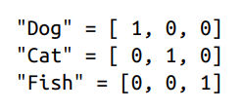
One-hot Encoding 1/4
Most machine learning models in MLlib expect numerical values as input, represented as vectors
To convert categorical values into numeric values, a technique called one-hot encoding (OHE) is used.
The numeric values used should not introduce any relationships to the data set.
Instead, a separate column for each distinct value is desired.
This does the same thing as pandas.get_dummies()

Slide 29
One-hot Encoding 2/4
The concern with memory consumption for data sets with potentially a large number of categories.
Spark internally uses a SparseVector when the majority of the entries are 0 (case with OHE).
It does not waste space storing 0 values.
DenseVector vs SparseVector
DenseVector(0, 0, 0, 7, 0, 2, 0, 0, 0, 0)
SparseVector(10, [3, 5], [7, 2])
SparseVector keeps track of the size of the vector (10), the indices of the nonzero elements ([3,5]), and the corresponding values at those indices ([7,2]).

Slide 30
One-hot Encoding 3/4
Ways to create one-hot encode
Use the StringIndexer and OneHotEncoder
Apply the StringIndexer estimator to convert categorical values into category indices
The category indices are ordered by label frequencies – most frequent label gets index 0.
Once the categories indices are created, they are passed as input to the OneHotEncoder
OneHotEncoder maps a column of category indices to a column of binary vectors.

Slide 31
One-hot Encoding 4/4
from pyspark.ml.feature import OneHotEncoder, StringIndexer
categoricalCols = [field for (field, dataType) in trainDF.dtypes
if dataType == "string"]
indexOutputCols = [x + "Index" for x in categoricalCols]
oheOutputCols = [x + "OHE" for x in categoricalCols]
stringIndexer = StringIndexer(inputCols=categoricalCols,
outputCols=indexOutputCols,
handleInvalid="skip")
oheEncoder = OneHotEncoder(inputCols=indexOutputCols,
outputCols=oheOutputCols)
numericCols = [field for (field, dataType) in trainDF.dtypes
if ((dataType == "double") & (field != "price"))]
assemblerInputs = oheOutputCols + numericCols
vecAssembler = VectorAssembler(inputCols=assemblerInputs,
outputCol="features")
from pyspark.ml.feature import OneHotEncoder, StringIndexer
categoricalCols = [field for (field, dataType) in trainDF.dtypes
if dataType == "string"]
indexOutputCols = [x + "Index" for x in categoricalCols]
oheOutputCols = [x + "OHE" for x in categoricalCols]
stringIndexer = StringIndexer(inputCols=categoricalCols,
outputCols=indexOutputCols,
handleInvalid="skip")
oheEncoder = OneHotEncoder(inputCols=indexOutputCols,
outputCols=oheOutputCols)
numericCols = [field for (field, dataType) in trainDF.dtypes
if ((dataType == "double") & (field != "price"))]
assemblerInputs = oheOutputCols + numericCols
vecAssembler = VectorAssembler(inputCols=assemblerInputs,
outputCol="features")

Slide 32
Feature Selection - RFormula
Another way to select features - using RFormula
Syntax is inspired by the R programming language.
The label and the features to be included are provided
It supports a limited subset of the R operators including (~, ., :, +,and -).
Examples:
formula = "y ~ bedrooms + bathrooms", predict y given just bedrooms and bathrooms,
formula = "y ~ .", use all of the available features (and automatically excludes y from the features).
y ~ bedrooms:bathrooms + bedrooms + bathrooms

Slide 33
Feature Selection - RFormula
Good
RFormula will automatically StringIndex and OHE all string columns, convert numeric columns to double type, and combine all of these into a single vector using VectorAssembler under the hood.
Look out!
OHE is not required or recommended for all algorithms.
Tree-based methods do not need OHE categorical features.
It will often make the tree-based models worse.

Slide 34
Evaluating the Model

Slide 35
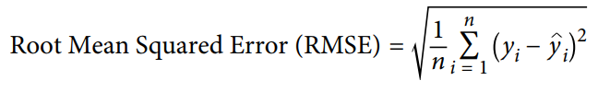
Evaluating Models - RMSE
In spark.ml, there are evaluators for classification, regression, clustering and ranking.
Root Mean-Square Error (RMSE) – commonly used regression metric
Ranges from zero to infinity
from pyspark.ml.evaluation import RegressionEvaluator
regressionEvaluator = RegressionEvaluator(
predictionCol="prediction",
labelCol="price",
metricName="rmse")
rmse = regressionEvaluator.evaluate(predDF)
print(f"RMSE is {rmse:.1f}")
Important!
Compare the RMSE against a baseline

Slide 36
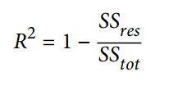
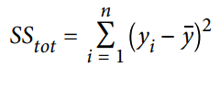
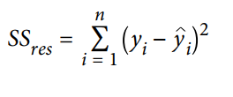
Evaluating Models – Coefficient of Determination (R²)
R² values range from negative infinity to 1.
When SS_{res} = 0, then R² = 1
If SS_{res} = Ss_{tot}, R² is 0, the model performs the same as always predicting the average value, y bar.
If SS_{res} is large (it performs worse than predicting the average, y bar), then R² is going to be negative.
r2 = regressionEvaluator.setMetricName("r2").evaluate(predDF)
R²
SS_{tot} is the total sum of squares when predicting y bar (average value)
Sum of Squared Errors. 0 when the model perfectly predicts every data points

Slide 37
Additional Reading
Learning Spark V2 Chapter 10
https://spark.apache.org/docs/latest/ml-guide.html

Slide 38

Lab
https://docs.databricks.com/applications/machine-learning/train-model/mllib/index.html#apache-spark-mllib-pipelines-and-structured-streaming-example

Slide 39

Questions

